Slide 1
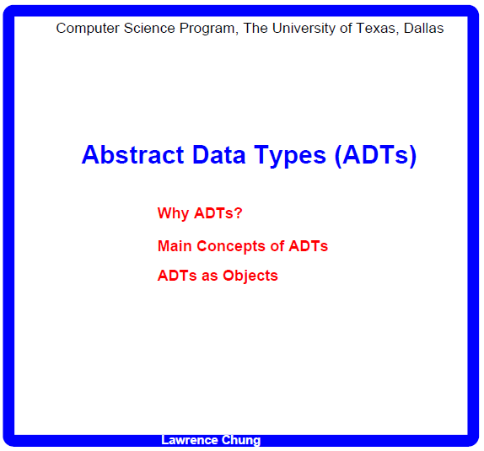

Slide 2
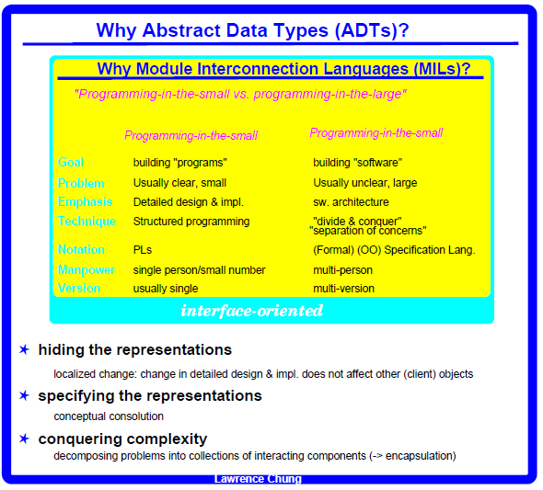

Slide 3
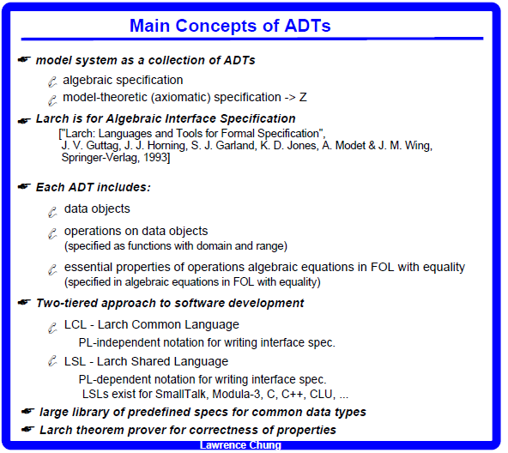

Slide 4
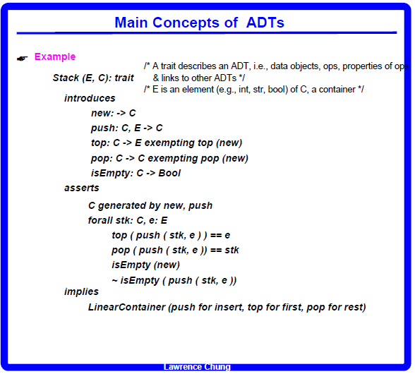

Slide 5
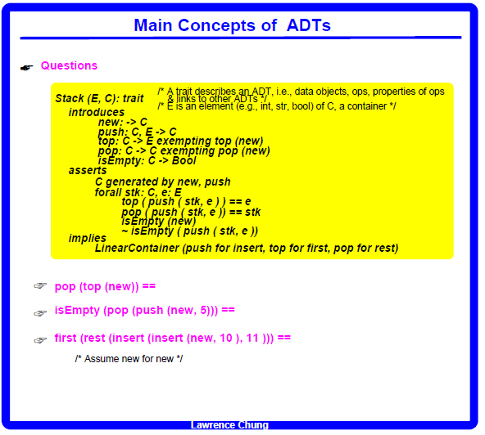

Slide 6
------------------------------------------------ (1)
------------------------------------------------ (2)
------------------------------------------------ (3)
------------------------------------------------ (4)
------------------------------------------------ (5)
------------------------------------------------ (6)
------------------------------------------------ (7)
------------------------------------------------ (8)
------------------------------------------------ (9)
------------------------ (10)
(3)
undefined
(7); stk<-new, e<-5
(8)
isEmpty (new)
== true
(10)
Top (pop (push (push (new, 10), 11))))

Slide 7
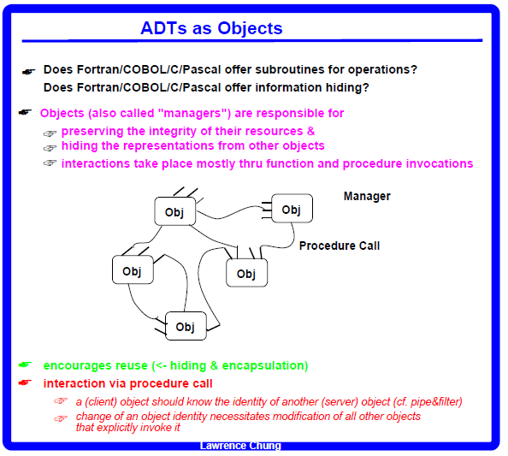

Slide 8
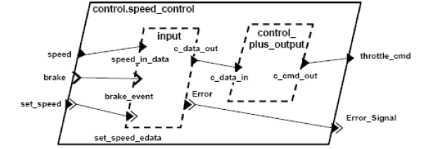
Architecture Description Languages (ADLs)
Cf. http://www.mrtc.mdh.se/han/FoPlan/ass2-bjornander.pdf
Architecture Analysis and Design Languages (AADL)
- for both hardware and software
- processors, buses, devices, ports, processes, threads and data
Rapide
- interfaces, events, timing constraints, etc.
Wright
- components, connectors and configurations (divided into instances)

Slide 9
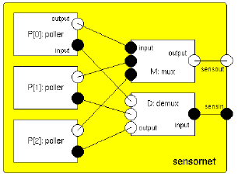
Architecture Description Languages (ADLs)
Cf. http://www.mrtc.mdh.se/han/FoPlan/ass2-bjornander.pdf
Darwin
- hierarchical composition
Aesop (The Architecture Design Environment Generator)
- based on the Unix environment, with pipe-and-filter style extensions
UML -> separate set of slides next

